Slide 1
Transition to Adult Living
TAL services are provided to youth in Child and Family Services custody 14 years and older regardless of permanency goal. Services are based on individual strengths and needs.

Slide 2
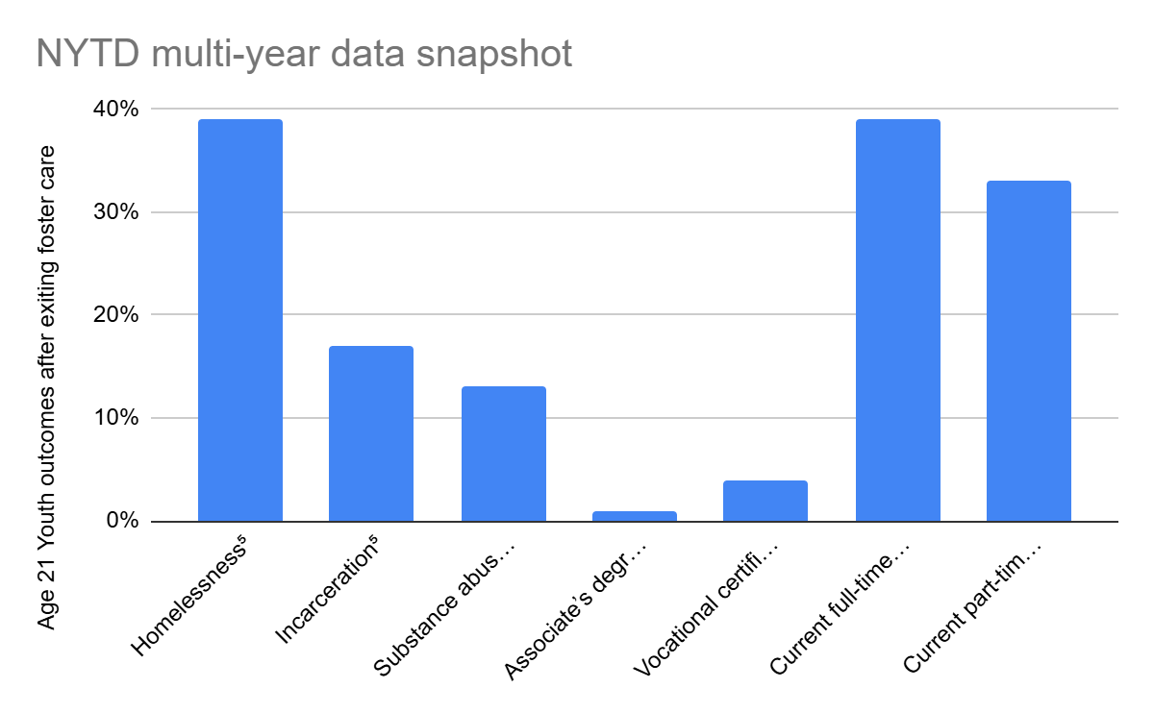
“ Teens in foster care are strong, resilient, and smart, and, given the chance, they can overcome their past and influence the world for better.”
–Aria Williams
John H Chafee Foster Care Program for Successful Transition to Adulthood
Youth Outcomes

Slide 3

Important considerations to improve outcomes for youth
FAFSA
Permanency at age 16+
  TAL Aftercare
  ETV
Emancipation at age 18+
  Reunification vs emancipation considerations for youth age 17
    Has the family stabilized?
  Court orders accurately reflecting age of majority vs reunification
  Medicaid
Permanency orders that accurately reflect the child’s living situation
Trusting youth voice

Slide 4

TAL UFACET: assessment, goal setting, support
Academic support
Academic skills
Post-secondary access
Post-secondary mentoring, support
Vocational planning
Employment
Employment retention
Budget and financial management
Housing
Home management skills
Basic health skills
Access to healthcare resources
Healthy relationships
Technology skills
Optimism towards future

Slide 5

TAL services for youth at age 14
Family connections
Permanency pact
  Youth can invite 2 support people for child and family team
TAL UFACET
Academic assistance through WIOA
Review credit report
Milestone workshops
Milestone guideline packet
Meet region TAL coordinator
Review permanency
Youth specific contact information

Slide 6

TAL services for
youth at age 15
All services listed on prior slide plus:
Develop a plan for earning and saving money
Open a checking or savings account
Increased emphasis on vocational skills for job readiness and preparation

Slide 7

TAL services for
youth at age 16
In addition to all services listed above:
Identify 5 personal connections
Be current with school credits in preparation for high school graduation or plan for GED or vocational training
Youth with goals for post-secondary education should prepare for and complete needed testing

Slide 8

TAL services for
youth at age 16
(continued)
Explore employment
Get a part time job.
Complete drivers education and receive a driver license
Obtain a state identification card if unable to get a driver license
Youth begin to facilitate the child and family team meetings
If appropriate, put name on waiting list at housing authority

Slide 9

TAL services for
youth at age 17
In addition to all services listed above:
Help obtain a driver’s license for a youth who does not have one 6 months before 18th birthday
Enroll youth in WIOA program during semester they are expected to graduate or obtain a GED
Assist with connecting to health provider, mental health authority
Update youth contact in SAFE

Slide 10

Prior to exiting care
In addition to all services listed above:
Exit plan that includes:
  Personal connections
  Ongoing support services
  Housing
  Health insurance
  Vocational, educational goals
  Employment
Meet with a nurse
Medicaid application (signature)
Important documents
Health and educational records
Aftercare services
NYTD survey and incentives
Review credit reports

Slide 11

Skills include education and vocation
FInancial literacy and money management
Household management
Obtaining, maintaining housing
Buying, maintaining a vehicle
Healthy relationships
Health, mental health, and wellbeing
Technology
Optimism towards future
Life skills of interest and suggested by the youth
Milestone classes and skills training opportunities

Slide 12

Academic milestones
Employment
Money management and budgeting milestones
Housing and home management milestones
Healthcare milestones
Healthy relationships milestones
Technology
Optimism towards future milestones
Milestone guideline incentive packet

Slide 13
Questions

Slide 14
State Office Northern Region
Jennifer Redd TAL Program Administrator Reyna Martinez Northern Region TAL Coordinator
Email: jredd@utah.gov Phone: 435-260-8250 Email: rrmartinez@utah.gov Phone: 435-213-6990
Rachel Trane Lived Experience TAL Coordinator Melissa McDonough Northern Region Program Admin
Email: rtrane@utah.gov Phone: 385-348-1274 mmcdonough@utah.gov Phone: 385-205-7219
Salt Lake Valley Region Western Region
Kayla Moosman SLVR TAL Coordinator Milton Gale Western Region TAL Coordinator
Email: kaylamoosman@utah.gov Phone: 801-671-3616 Email: ggale@utah.gov Phone: 801-874-6600
Darcie Peterson SLVR Program Administrator Jeramie Rasmussen Western Region Program Admin
Email: darciepeterson@utah.gov Phone: 801-755-7428 Email: jgrasmus@utah.gov Phone: 801-319-5940
Southwest Region Eastern Region
Kaylee Beebe Southwest Region TAL Coordinator Jesse Sitterud Eastern Region TAL Coordinator
Email: kjbeebe@utah.gov Phone: 435-421-1720 Email: jessesitterud@utah.gov Phone: 435-749-2986
Elizabeth Cruz Southwest Region TAL Supervisor Nicole Moore Eastern Region Program Administrator
Email: esoriano@utah.gov Phone: 435-216-6205 Email: nicolemoore@utah.gov Phone: 435-381-4737
Regional TAL Coordinators and Support

